Slide 1
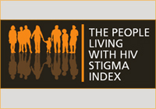
Stigma Index Project
Vanessa Johnson, JD
US PLHIV Caucus
September 13, 2016
Notes:
Thank you to organizers.
My name is Vanessa Johnson. I am a woman who has been living with HIV for the past 28 years.
I am presenting on behalf of the US PLHIV Caucus.
I am delighted to be here to speak about a community-based research and action project , that may be near and dear to nearly everyone in this room: The People Living with HIV Stigma Index (Stigma Index Project for short).
The purpose of this presentation is to:
Share updates about the Stigma Index Project in the U.S.
Acknowledge efforts of stigma reduction efforts that have been lead by people with HIV around the world through this project.

Slide 2
United States People Living with HIV Caucus
The United States People Living with HIV Caucus (the HIV Caucus) has taken on the lead coordination of the Stigma Index as of 2016
Photo credit: Poz Magazine (2013)

Slide 3
United States People Living with HIV Caucus
A network of national networks of PLHIV and community leaders
Emerged 2010 with the dissolution of National Association of People with AIDS
Host AIDS Watch and other community based PLHIV community work

Slide 4
Stigma Conceptualized
Stigma is a social process:
Contextual (social, cultural, political & economic forces)
Turns “difference” into inequity
Devaluation to create superiority
Social exclusion of individuals or groups
Disqualification from full social acceptance
Notes:
Parker and Aggleton argue that part of the reason we have not been able to effectively address HIV stigma and discrimination is that our conceptualization of the issue has not mirrored its complexity.
They offer a framework that emphasizes stigma as a social process that produces and reproduces relations of power and control and examines how stigma is used to turn difference into inequity—including inequity based on gender, age, sexual orientation, class, race or ethnicity, thus allowing some groups to devalue others.
Stigma and discrimination is used by dominant groups to produce, legitimize and perpetuate social inequality; social control exerted through social exclusion; limits ability of stigmatized groups & individuals to resist or fight back against the stigma

Slide 5
Discrimination Defined
Unfair and unjust action toward an individual or group on the basis of:
Real or perceived status or attributes
Medical condition like HIV & AIDS
Socio-economic status
Gender
Race
Sexual orientation or sexuality

Slide 6
The first PLHIV document to address stigma
Photo credit, Peter Staley (1983)
Notes:
This project is grounded in the Denver Principles (1983) and internationally recognized GIPA principle, which requires the Greater Involvement of People Living with HIV/AIDS in all aspects of the HIV response.
The GIPA Principle has been adopted repeatedly by the member states of the UN General Assembly – including the United States. It recognizes the rights and responsibilities of people living with HIV including our right to self-determination and participation in decision-making.

Slide 7
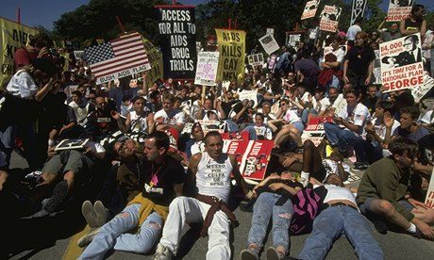
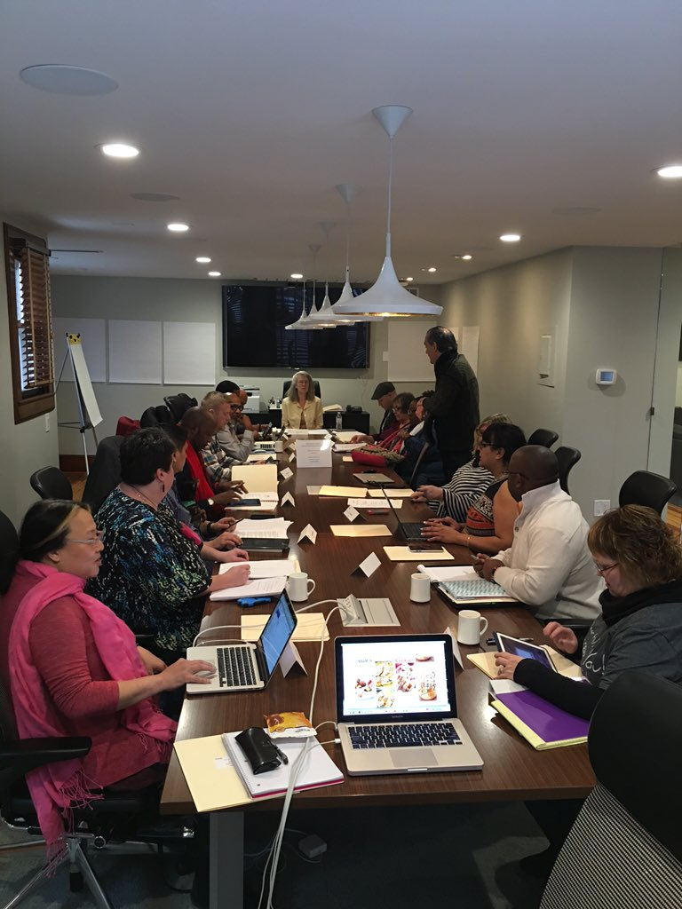
HIV = A history of self-empowerment
John J. Wilcox LGBT Archives of Philadelphia
Act Up, 1991. Photograph: Dirck Halstead/Time & Life Pictures/Getty Images
Network Empowerment Project Meeting, 2016, Milford, PA. Photograph: Ken Pinkela/Sero Project

Slide 8
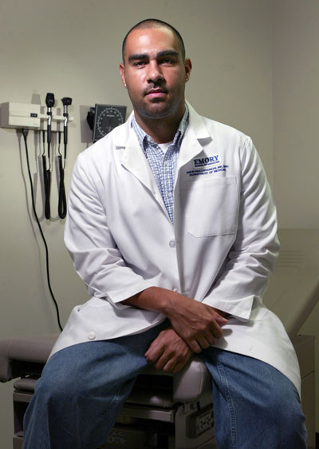
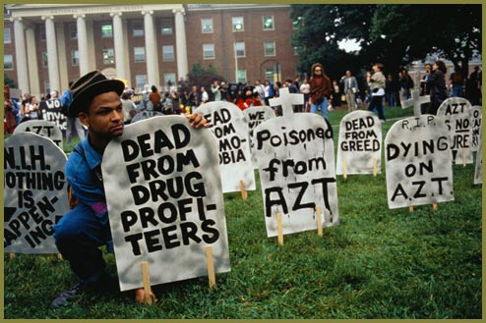
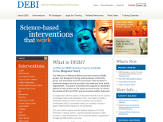
From grassroots to boxes to clinics: HIV services
Grassroots,
Homegrown
interventions
DEBIs:
Interventions
“in a box”
Services moving
toward clinic
settings
Late 1980s – Early 1990s – Late 1990s – Early 2000s – Late 2000s – 2010: NHAS
Notes:
8
Explain that this is not an exact representation, there is a lot of overlap. For example, grassroots/homegrown interventions have continued even as DEBIs were at the height of being funded/implemented. And both homegrown and debis will continue as HIP is implemented and many services move toward the clinic settings. This is meant to represent periods during the epidemic when so-called disruptive innovations have come into practice.
Ask participants if they know of CBOs that have been around for 20+ years. How have these CBOs adapted to the changes in the prevention landscape over the years?

Slide 9
The Stigma Index Overview
HIV stigma is a social phenomena experienced personally
Coordinated by Global Network of People Living with HIV (GNP+) to measure HIV stigma – conducted in 50 countries
The Stigma Index data is collected and analyzed by PLHIV, with PLHIV, and for PLHIV
Stigma Index findings drive policy and community organizing efforts
For more information on global projects using the questionnaire see http://www.stigmaindex.org/
Notes:
PARTNERSHIP
The Stigma Index is led by an International Partnership of:
The International Community of Women Living with HIV
The Joint United Nations Programme on HIV/AIDS
The Global Network of People Living with HIV
In the U.S. – The U.S. People Living with HIV Caucus (HIV Caucus)
GLOBAL
Globally, the Stigma Index has been implemented in 50 countries and on every continent. As of July, over 40,000 people living with HIV had been interviewed, including significant number of key populations, such as over 3800 people who use or have used drugs, over 2800 men who have sex with men, and over 1500 people who have been incarcerated.
The Stigma Index follows a 5 part process that starts by building partnerships that are inclusive of all communities most affected by HIV; continues with capacity-building and training; then enters the interview stage; followed by data analysis and interpretation; and culminating with action to address HIV-related stigma and discrimination at the community level, state level, and national level. The questionnaire is quite extensive and covers these eleven areas related to HIV stigma and discrimination.
The twelve (12) areas are:
Experience of stigma & discrimination from others
Access to work, education, and heath services
Internal stigma and fears
Rights, laws and policies
Effecting change
Testing & diagnosis
Disclosure & confidentiality
Treatment
Having children & reproductive and sexual health care
Self-assessment of effects of stigma & discrimination
Barriers to testing and treatment (additional module)
Country-specific questions
In relationship to the community-research aspects of this project, people living with HIV who are trained interviewers sit side by side with other people living with HIV to complete a survey that documents experiences of stigma, discrimination, and rights violations, as well as strategies to resist, challenge, and thrive.
Networks of people living with HIV and community organizations work with government and academic partners to analyze the results and then people with HIV are supported to develop advocacy priorities and actions to address the areas that they determine are most critical.
The process of the research – the processes of training, employing, building research and data literacy, and community building and organizing -- these processes are as important as the results.
UNITED STATES
Here is a brief update on the Stigma Index project in the US. This year we have put together a national steering committee of community, academic, and public health leaders – more than 80% of whom are openly living with HIV – with research, policy, and community organizing experience. The project is being piloted in Detroit, Michigan and the eight sites shown here were selected by the steering committee to ensure the inclusion of the broadest diversity of people living with HIV.
Over the next three years, the project will be implemented in stages in these sites, dependent on the funding we are able to raise.

Slide 10
The Stigma Index Process
Partnership
Capacity-building
Listening to the community
Data analysis and interpretation
Advocacy
10
Notes:
Partnership -- an inclusive partnership, with a focus on full and meaningful participations by the communities hardest hit by the epidemic, leads the process
Capacity-building – PLHIV networks and other community based organizations prepare to manage the program and resulting advocacy campaigns. Individual people with HIV are trained as interviewers
Listening to the community -- interviewers sit with other people living with HIV, go through the Stigma Index questionnaire and document their responses and stories
Data analysis and interpretation — responses to the survey and to follow up interviews are analyzed by academic partners and the results are interpreted jointly between researchers and members of communities of people living with HIV
Advocacy — local and national communities of people living with HIV determine priorities and actions for addressing HIV-related stigma and discrimination.

Slide 11
The Stigma Index Goals
Document
Mobilize
Reduce stigma
Develop PLHIV research literacy
Provide an evidence base framework
Build and implement a shared advocacy agenda
Notes:
Document experiences of stigma and discrimination;
Mobilize and provide support to networks of key populations and people living with HIV, supporting their joint efforts to improve the well-being of the most marginalized affected groups;
Reduce internalized stigma and build resilience and the capacity to bring change;
Develop the research literacy of people living with HIV and key populations, supporting their greater understanding and use of data on the social aspects of HIV stigma and discrimination;
Provide an evidence base to inform interventions focused on community identified needs; and
Build and implement a shared advocacy agenda across people living with HIV and key populations, designed for impact in addressing the barriers to well-being created by HIV-related stigma and discrimination.

Slide 12
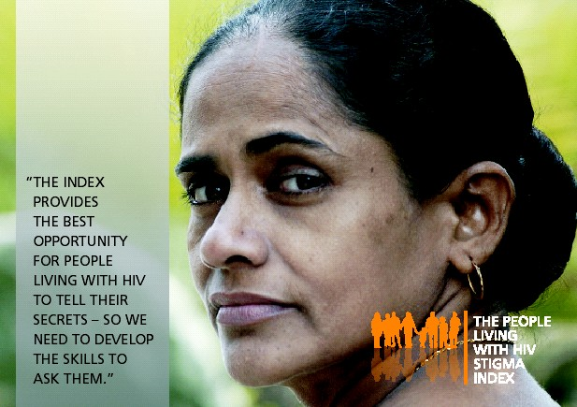
Notes:
Research
Documents experiences of stigma, discrimination, and rights violations of people living with HIV
Community-based and participative: led by local, diverse, and inclusive groups of people living with HIV
Founded in the principle of the Greater Involvement of People Living with HIV and AIDS (GIPA): building evidence, solidarity, and empowerment
Action
Supporting communities to use the data results and their local expertise to create evidence-based programs and advocacy work
The process is as important as the results

Slide 13
“Being interviewed by another person living with HIV does make a difference – you feel they really understand more about how you feel.”
13

Slide 15
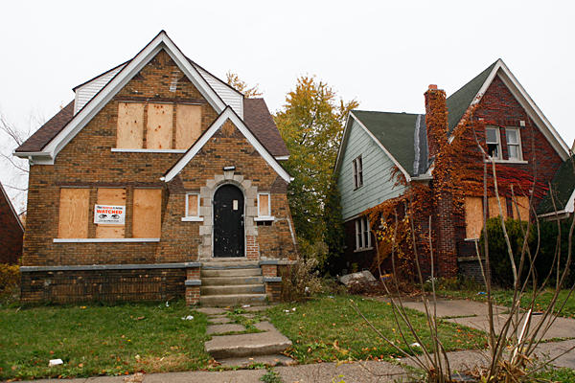
Detroit, MI
Detroit is the first US implementation
As a pilot, pulled together advisory group of local PLHIV (14 African Americans, 2 Latinas, 1 White)
Initial expectations of all parties revolved around Detroit “issues” and HIV
Notes:
Partnership between AIDS Partnership Michigan and Sex Lab: The Center for Sexuality and Health Disparities.

Slide 16
Year 1 Findings
80% experienced negative feelings of self-blame and guilt about being HIV positive
73% experienced at least one form of social discrimination, most commonly hearing gossip about their HIV status and being sexually rejected by potential partners
20% experienced at least one form of institutional discrimination, predominately related to healthcare, housing, and insurance access
20% felt that their rights as a person living with HIV had been violated or abused
Notes:
Among the 70 SI Questionnaire participants

Slide 17
Terminology of Stigma
Enacted stigma (discrimination)
Anticipated stigma
Internalized stigma
Secondary stigma
Intersecting stigma
Gender
Poverty/class/race/geography
Sexuality or sexual orientation
Notes:
Enacted stigma—actual experiences of discrimination e.g. a woman being beaten by her husband after revealing that she is HIV-positive
Felt stigma—real or imagined fear of societal attitudes and potential discrimination e.g. fears around being divorced if HIV-positive
Internalized stigma—acceptance of one’s “lesser status”, manifesting in low self-esteem, sense of worth, self-blame, self-isolation/withdrawal
Secondary stigma—stigma of those associated with PLHA—family, partners, friends, caregivers. HCW
Compound stigma—experience of multiple (layered) stigmas:

Slide 18
Notes:
Percent experiencing these feelings in the last 12 months.

Slide 19
Discrimination in the last 12 months
Denied healthcare services, including dental services, because of HIV status | 10% | 7
Did this happen while incarcerated? | 43% | 3
Denied sexual and reproductive health services, because of HIV status | 8.6% | 6
Did this happen while incarcerated? | 16.6% | 1
Housing discrimination (forced to move or denied rental lease) | 17% | 12
Percent due to HIV status (wholly or in part) | 50% | 6
Employment discrimination (lost a job or source of income if self-employed) | 15.7% | 11
Percent due to HIV status (wholly or in part) | 27% | 3

Slide 20
Effects of Stigma and Discrimination
Depression | 59% (41)
Anxiety | 47% (33)
Withdrew from family or friends | 44% (31)
Reduced exercise, physical activity, or sleep | 30% (21)
Avoided social support | 23% (16)
Increased drug or alcohol use | 21% (15)
Withdrew from faith-based or spiritual support | 20% (14)
Missed doses of medication | 17% (12)
Income loss | 11% (8)
Avoided health care | 11% (8)
Missed days of school or work | 9% (6)
Notes:
New question written by US steering committee.

Slide 22
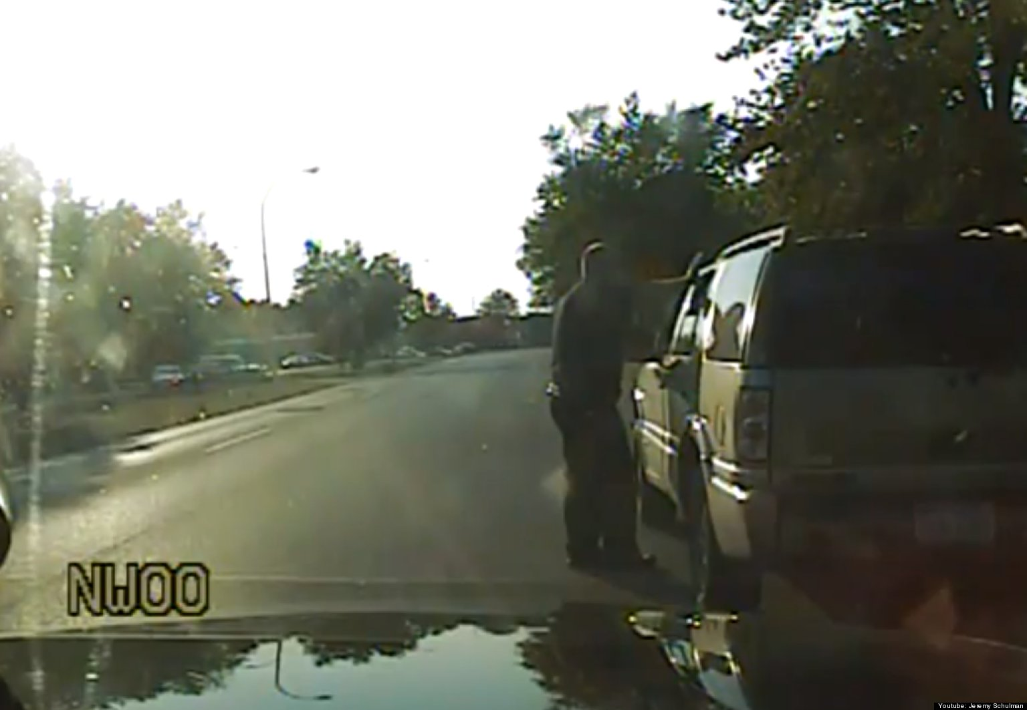
Year 2 Plans: Applying the Results
Develop Policy Agenda around:
Rights advocacy and defense
Equity knowledge promotion
Trans* and cis-women
Advisory group consists of 20 now-active local people living with HIV
New coalitions of trans* women, and youth
Notes:
Internalized stigma and empowerment
Legislative action to remove HIV criminalization laws
Institutional stigma and barriers to care
Partnering with religious leaders to address stigma within and outside of faith settings (Framework for Dialogue)

Slide 23
Activities of Resilience and Support
Notes:
For first column: support = Emotional, Referral, Physical

Slide 24
Timeline
January - June
July - December
2013
Establish National Steering Committee
Site 1: Implementation and data analysis
Finalize Implementation Plan
Site 2: Implementation
2014
Site 1: Advocacy training and planning
Site 1: Community-led advocacy work
Site 2: Data analysis
Site 2: Advocacy training and planning
Site 2: Advocacy work
Sites 3-5: Implementation and data analysis
Sites 3-5: Advocacy training and planning
2015
National: Data analysis
National
Advocacy training
Advocacy planning
Community-led advocacy work
Site 2: Community-led advocacy work
Sites 3-5: Community-led advocacy work
24

Slide 25
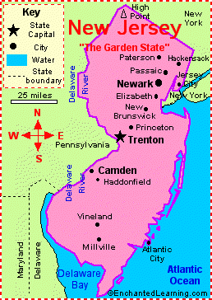
Current Status - Stigma Index Sites
Stigma Index Implementation:
Louisiana (first phase)
New Jersey
Alaska
New York City
Training covered intercultural and health communication, as well as ethics and qualitative research methods

Slide 26
Thank you
To you for your commitment to ending HIV-related stigma and discrimination in Louisiana;
Presented with deep appreciation for the more than 40,000 people living with HIV from around the world who have shared their knowledge and experiences and made the PLHIV Stigma Index project possible; and

Slide 27
Questions?
United States People Living with HIV Caucus
www.hivcaucus.org
Global Network of People Living with AIDS
The Stigma Index Project
Vanessa Johnson, JD
vjohnson84bj@gmail.com |301-768-2852
www.ribbonconsultinggroup.com
Notes:
There are a few ways to get involved with the Stigma Index project:
First, we need more funding for the project. We are working diligently to raise the funds needed to support these implementations, particularly in impoverished areas in the U.S.
If you are in an area that has been selected as an implementation site and would like to be involved, please let us know.
If you are not in a selected area but want to be kept informed, let us know that as well.
Feel free to contact:

